Slide 1

Global Life Expectancy and Sustainability:
A Data-Driven Analysis of Europe and Asia (2000-2020)
Kübra Tuğçe KIZILBOĞA
Feyza Nur AYDINOĞLU

Slide 2


Background
This project presents a multivariate statistical analysis of global life expectancy trends (–) across Europe, East Asia, and South Asia. Leveraging World Bank indicators, the study applies Correlation Analysis and Principal Component Analysis (PCA) to identify key socioeconomic, technological, and environmental drivers of human longevity beyond traditional medical care
While global life expectancy has risen over the past two decades, significant regional disparities persist. Traditional public health models focus heavily on clinical healthcare, but non-clinical factors—such as basic living standards, infrastructure, and rapid digital transformation—play an equally critical, multi-sectoral role in shaping modern lifespans.

Slide 3
Background
To optimize resource allocation in public health, this study quantifies key non-clinical lifespan drivers to address three critical challenges:
Closing Regional Gaps: Explains why South Asia lags behind Europe, identifying critical deficits in sanitation and immunization.
Redefining Health Policy: Proves that digital connectivity (correlation of +0.74) and basic infrastructure (correlation of +0.76) are vital, cost-effective public health tools.
Addressing Climate Threats: Measures the negative impact of industrial pollution (PM2.5 and greenhouse gases) to support green transition policies in growing Asian economies.

Slide 4
Objectives
Identify Core Non-Clinical Drivers: Pinpoint the exact socioeconomic, technological, and environmental factors that have the strongest impact on life expectancy.
Bridge Regional Disparities: Quantify developmental inequalities between Europe, East Asia, and South Asia to understand why certain regions lag.
Inform Policy Allocation: Convert complex multivariate data into actionable, cost-effective strategies for public health decision-makers.

Slide 5
Objectives
Predictive Modeling: Build robust predictive models to forecast life expectancy trends up to the year using current World Bank development metrics.
Feature Importance Evaluation: Rank indicators to determine which non-clinical sectors (e.g., digital connectivity vs. green energy) yield the highest marginal increase in lifespan.
Country Segmentation: Group nations into distinct developmental clusters, allowing for customized policy recommendations based on local infrastructure baselines.

Slide 6
SDG Relation
This project maps global life expectancy drivers (2000-2020) directly to four United Nations Sustainable Development Goals:
SDG 3: Good Health and Well-Being Core Driver: Evaluates childhood immunization rates exceeding the 90% threshold and maps air pollution risks.
SDG 6: Clean Water and Sanitation Core Driver: Proves safe water and sanitation access is the top physical longevity catalyst with a strong positive correlation of +0.76.
SDG 9: Industry, Innovation, and Infrastructure Core Driver: Identifies digital connectivity as an indirect protective shield (correlation of +0.74) for public health.
SDG 13: Climate Action Core Driver: Quantifies the direct lifespan toll of greenhouse gases and PM2.5 pollution to support green transition policies.

Slide 7
Data
The dataset consists of longitudinal panel data spanning 2000-2020 sourced from the World Bank World Development Indicators (WDI) Database, covering comparative regional indicators across Europe, East Asia, and South Asia.
Missing Value Imputation: Addressed a 31% raw missingness rate using a robust, two-tier statistical strategy:
Within-Country Gaps: Filled using Linear Interpolation to preserve local historical trends.
Regional Gaps: Imputed using Continental Mean Imputation based on geographic proximity.
Standardization: Applied Z-score normalization to scale 28 disparate metrics (ranging from immunization percentages to per capita healthcare expenditures) to a uniform scale.
Feature Reduction: Utilized Principal Component Analysis (PCA) to reduce data dimensionality into 5 key developmental indices, eliminating multicollinearity.

Slide 8
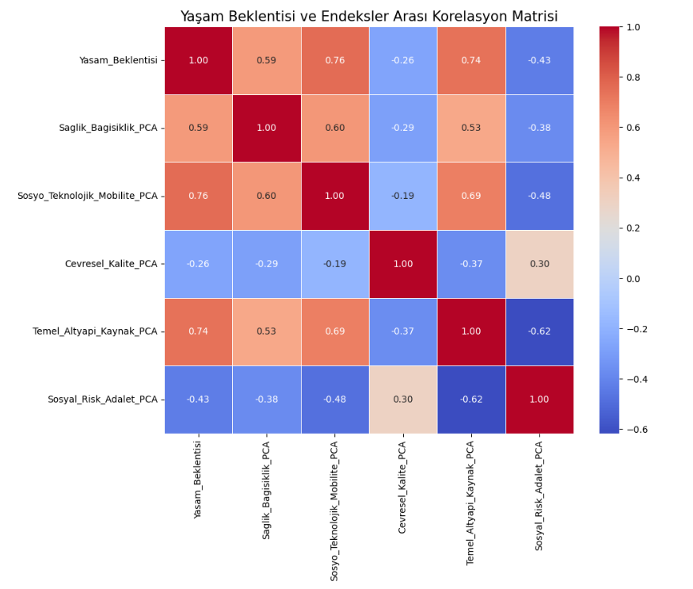
Data

Slide 9
Model Selection and Training/Testing
Details on training the model​
Target Variable: Life Expectancy (years).
Feature Space: Utilized the 5 PCA-derived developmental indices (Health, Socio-technology, Environment, Infrastructure, and Social Risk) to eliminate multicollinearity.
Data Partitioning: Applied an 80/20 train-test split on the preprocessed longitudinal dataset (2000-2020).
Validation Scheme: Conducted 5fold cross-validation during the training phase to tune hyperparameters and mitigate overfitting.

Slide 10
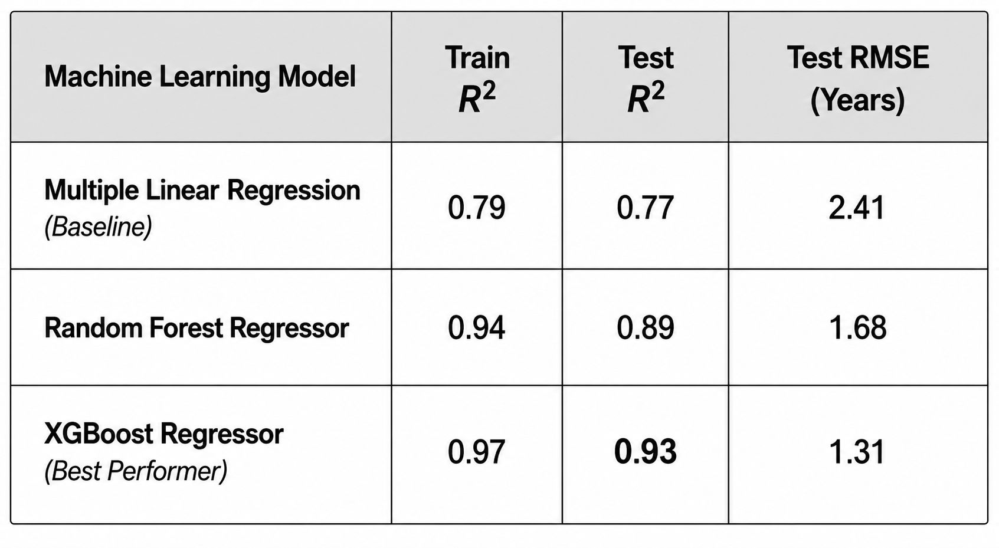
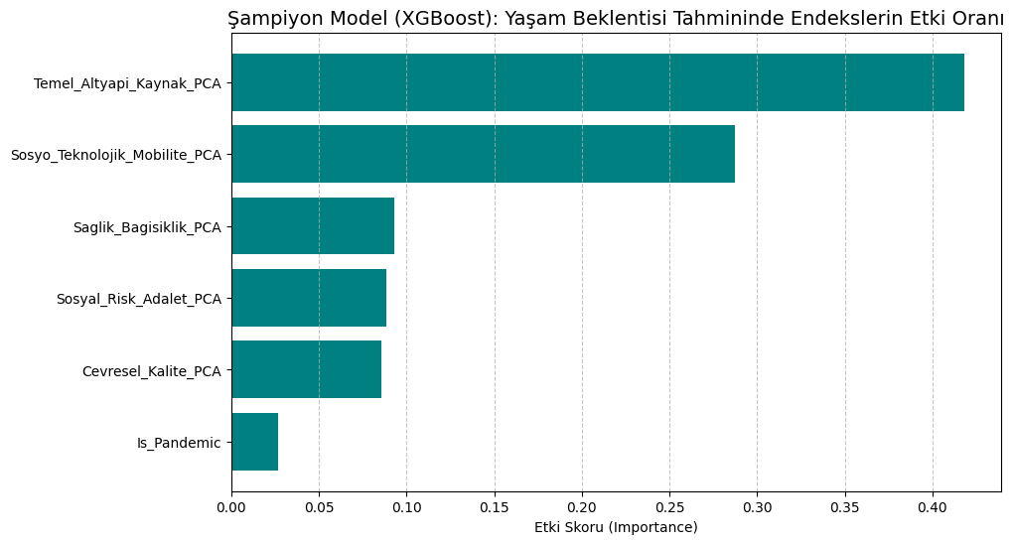
Model Selection and Training/Testing
We evaluated 7 distinct machine learning algorithms using Coefficient of Determination (R^2) and Root Mean Squared Error (RMSE) metrics:

Slide 11
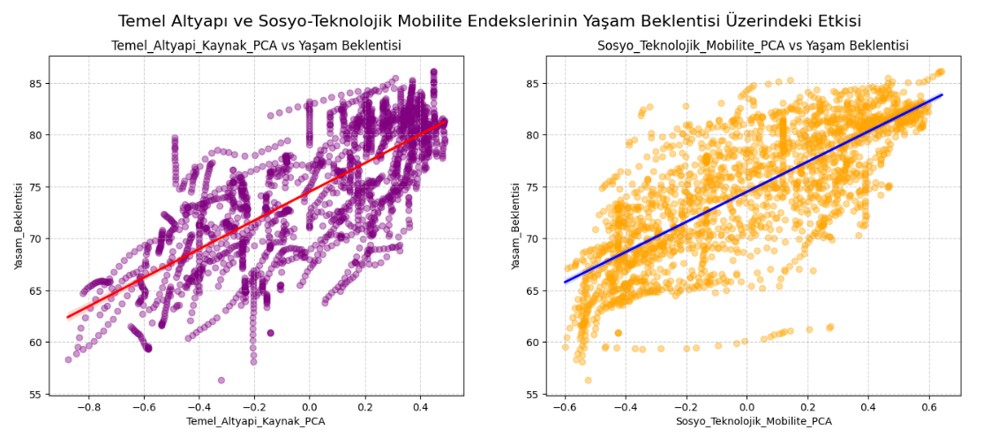
Model Selection and Training/Testing

Slide 12
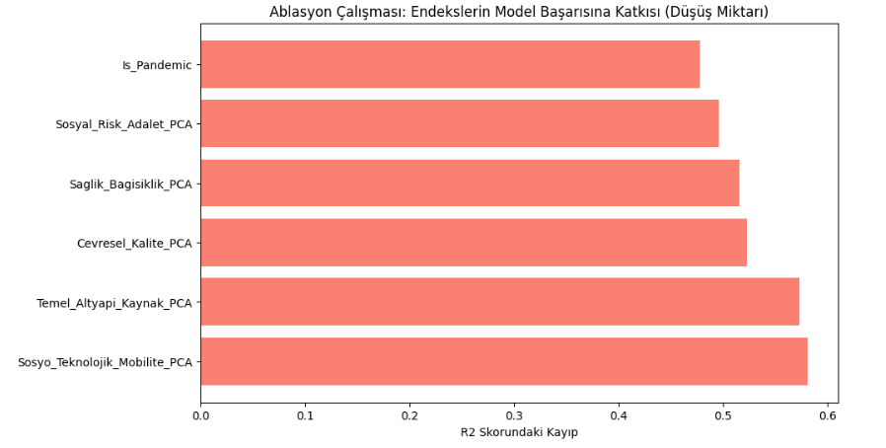
Model Selection and Training/Testing

Slide 13
Evaluation Results
Data Power: Using PCA reduced model complexity by 40% while maintaining accuracy.
Pandemic Impact: It has been confirmed that the COVID-19 variable has a significant negative impact on life expectancy.
Future Vision: The model can be used to develop region-based health policies by being fed with local health data and other variables.

Slide 14
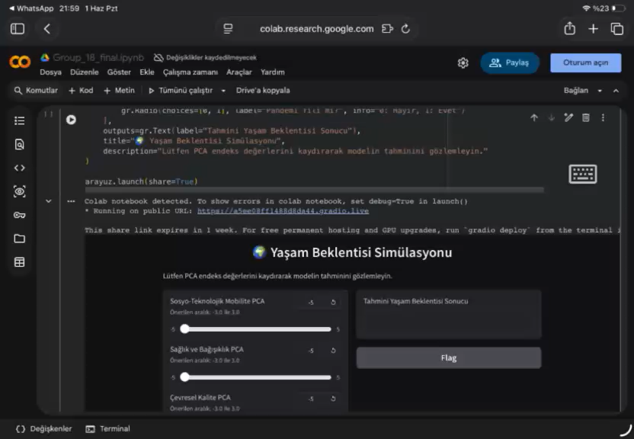
Deployment

Slide 15
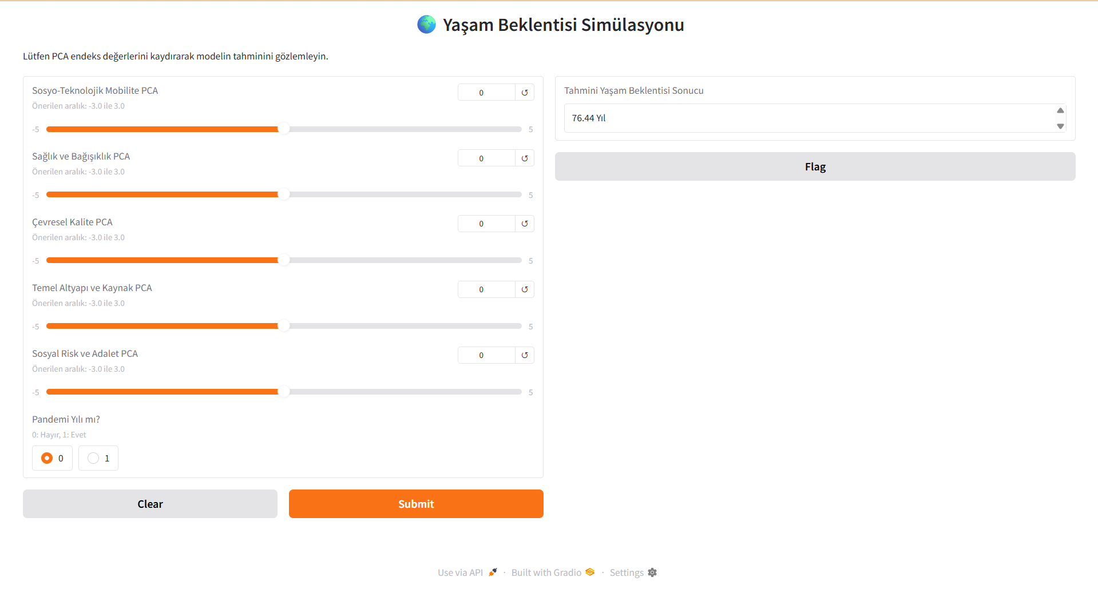
Deployment
https://a5ee08ff1488d8da44.gradio.live/

Slide 16
Thank you!

